Slide 1
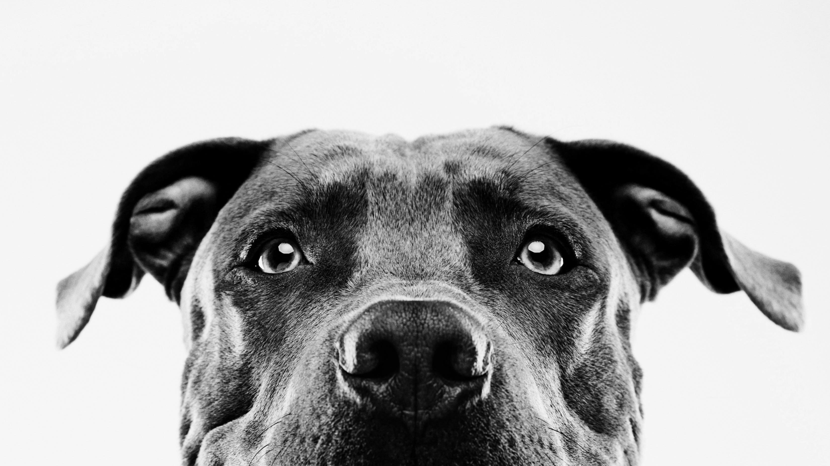
SDLC
Development and Testing

Slide 2
SDLC: Developing and testing the product
Creating the prototype
Creating a prototype
  This is the work we have been doing (outlining tickets in a sprint to build towards a single release)
  The prototype allows for further testing
  The prototype will also be used for demo’ing the work to the customer before release

Slide 3
SDLC: Developing and testing the product testing
When a ticket is accepted into the sprint, generally 2 different people will work on it
  The developer, who will create the actual code
  The tester, who will develop Test Cases based on User Acceptance Criteria

Slide 4
SDLC: Developing and testing the product testing
As each ticket is worked on, the developer will also create “unit tests” for all the code written
  Unit Tests are automated tests that load the code, run it in a sandbox environment, and confirm it does what is expected
  This allows the development team to be sure the code is working even if other parts of the code are changed, without testing everything every time

Slide 5
SDLC: Developing and testing the product testing
Once they have completed the code, there will be several rounds of functional testing
  The developer will then perform “Integration Testing”, where they test their code in combination with all other code
  If several systems are involved, the developer will perform “System Testing”, which ensures their code works with the multiple systems
  They will then assign the ticket to the tester

Slide 6
SDLC: Developing and testing the product
Testing
The tester (usually a dedicated software tester/test-team member) will then perform User Acceptance Testing
  User Acceptance Testing is where the test-team member confirms the features match with what the customer actually asked for
  When they first received the ticket, they’ll write up test cases that match the features being developed and how to test them based off what the customer stated they wanted
If any level of testing fails, the ticket is kicked back to development to be fixed
If every level of testing passes, the ticket progresses to the customer demo

Slide 7
SDLC: Developing and testing the product
Customer Demo
Finally, if the tester approves the ticket, it goes in a “Completed” queue.
A few days before the end of the sprint the customer (or Product Owner) is brought in. The development team then demonstrates each of the features they developed to this person
The customer/product-owner then accepts the work, rejects it, or asks for revision

Slide 8
SDLC: Developing and testing the product
Customer Demo
If the customer accepts the work:
  The ticket is flagged to go into the next release and is marked as done
If the customer rejects the work:
  The feature is revealed to be undesired and removed from the project
  The developer will need to redo the feature from scratch
If the customer asks for revision:
  If the changes are minor, then the code is quickly fixed, tested, and (if necessary) demo’d again
  If the changes are optional and wouldn’t affect current functionality, then the feature is released and a new ticket is created to add the upgraded functionality
  If the changes are required then the ticket is bumped back down to development and added into the next sprint

